Slide 1
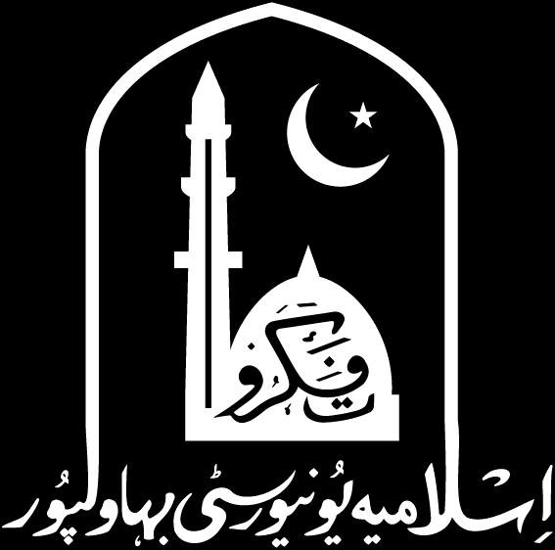

Greedy Algorithms
14
PART IV · THE DESIGN PARADIGMS
CHAPTER 14 · WEEK 10
Design, Proof and Measurement
LECTURER
Dr. Mustafa Hameed
THE ISLAMIA UNIVERSITY OF BAHAWALPUR
Bahawalpur, Pakistan
Department of Information Technology · BSIT · Fall 2026
Notes:
Chapter 14: Greedy Algorithms. Part 4 — The Design Paradigms. Week 10: Greedy algorithms and exchange arguments. Handout pages 113–120.

Slide 2

Where this chapter sits
THE COURSE
PART I
PART II
PART III
PART IV
PART V
PART VI
1
2
3
4
5
6
7
8
9
10
11
12
13
14
15
16
17
18
19
20
21
22
23
Greedy Algorithms
BUILDS ON
USED LATER IN
Ch 7 Brute Force, and When It Is the Right Answer
Ch 15 Dynamic Programming I: The Elements
Ch 12 Heaps and Search Trees, Revisited for Analysis
Ch 19 Minimum Spanning Trees
Ch 20 Shortest Paths: Single-Source and All-Pairs
Analysis of Algorithms · Chapter 14 · Greedy Algorithms
Handout p. 113 2
Notes:
Place the chapter. Before you start: Chapter 7 for the baseline and the oracle technique. Nothing else in Part II is required, though Chapter 12’s heap is the data structure Huffman’s algorithm runs on.

Slide 3

What you will be able to do
LEARNING OUTCOMES
By the end of this chapter you will be able to:
1
Define the greedy strategy and apply it to a stated problem (CLO-6).
2
State the greedy-choice property and optimal substructure, and explain why both are needed.
3
Prove a greedy algorithm optimal by an exchange argument.
4
Construct a counter-example showing a plausible greedy rule is not optimal.
5
Describe Huffman coding and relate its output to the entropy bound.
Analysis of Algorithms · Chapter 14 · Greedy Algorithms
Handout p. 113 3
Notes:
Read these out: they are the chapter's contract with the room. Each click adds one.

Slide 4

Vocabulary for this chapter
KEY TERMS
greedy algorithm
greedy-choice property
optimal substructure
exchange argument
activity selection
counter-example
Huffman code
prefix code
entropy
matroid
Each term is defined where it first matters — not here.
Analysis of Algorithms · Chapter 14 · Greedy Algorithms
Handout p. 113 4
Notes:
Do not define these now; they arrive one at a time. This slide is for the students' notes. Terms: greedy algorithm; greedy-choice property; optimal substructure; exchange argument; activity selection; counter-example; Huffman code; prefix code; entropy; matroid.

Slide 5
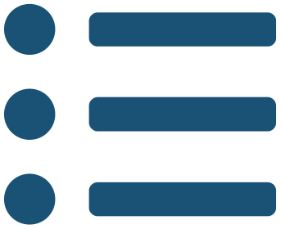
In this chapter
IN THIS CHAPTER
14.1
Commit and Never Reconsider
p. 113 ›
14.2
Activity Selection
p. 114 ›
14.3
When Greedy Fails: Coin Change
p. 115 ›
14.4
Huffman Coding
p. 116 ›
Analysis of Algorithms · Chapter 14 · Greedy Algorithms
Handout pp. 113–120 5
Notes:
The route through the chapter. Each row is a link: click it to jump to that section in the slide show.

Slide 6
Commit and Never Reconsider
SECTION 1 OF 4
14.1
14.1 Commit and Never Reconsider
14.2 Activity Selection
14.3 When Greedy Fails: Coin Change
14.4 Huffman Coding
Analysis of Algorithms · Chapter 14
Handout §14.1 6
Notes:
Pause. Name the question this section answers.

Slide 7

Greedy Algorithm
DEFINITION
A greedy algorithm builds a solution one step at a time, at each step taking the option that looks best right now, by some local rule, and never revisiting that decision.
It is the simplest strategy in the book and the one most often wrong. What makes it interesting is that when it works, it is usually both the fastest algorithm available and the easiest to implement — and whether it works is decidable by a proof, not by testing.
Analysis of Algorithms · Chapter 14 · Greedy Algorithms
§14.1 · Handout p. 113 7
Notes:
Read the box aloud, then ask for an example from the room before moving on.

Slide 8

The two properties
CONCEPT
A greedy algorithm is optimal when the problem has both of these.
1. The greedy-choice property. A globally optimal solution can be reached by making a locally optimal choice. More precisely: there exists an optimal solution that contains the greedy first choice. Note the “there exists” — greedy need not find the optimal solution, only an optimal one.
2. Optimal substructure. An optimal solution to the problem contains within it optimal solutions to the subproblems that remain after the choice.
Both are required and they are different. Optimal substructure alone gives you dynamic programming (Chapter 15); it is the greedy-choice property that lets you commit without exploring alternatives, and it is the one that usually fails. Chapter 15 returns to this comparison in full.
Analysis of Algorithms · Chapter 14 · Greedy Algorithms
§14.1 · Handout p. 113 8
Notes:
Read the box aloud, then ask for an example from the room before moving on.

Slide 9
Activity Selection
SECTION 2 OF 4
14.2
14.1 Commit and Never Reconsider
14.2 Activity Selection
14.3 When Greedy Fails: Coin Change
14.4 Huffman Coding
Analysis of Algorithms · Chapter 14
Handout §14.2 9
Notes:
Pause. Name the question this section answers.

Slide 10
Activity Selection
DEFINITION
Given n activities, activity i occupying the half-open interval [s_{i}, f_{i}), choose a largest set of mutually compatible activities — no two overlapping.
Analysis of Algorithms · Chapter 14 · Greedy Algorithms
§14.2 · Handout p. 114 10
Notes:
Read the box aloud, then ask for an example from the room before moving on.

Slide 11
Activity Selection
IN BRIEF
Three local rules suggest themselves, and they sound equally sensible:
• take the activity that finishes earliest;
• take the shortest activity;
• take the activity that starts earliest.
Analysis of Algorithms · Chapter 14 · Greedy Algorithms
§14.2 · Handout p. 114 11
Notes:
Read the box aloud, then ask for an example from the room before moving on.

Slide 12
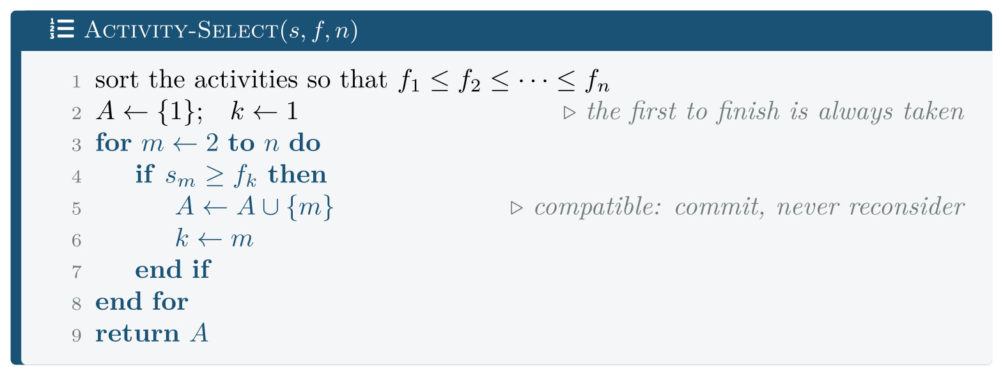
Activity-Select, greedy by earliest finishing time
FIGURE 14.1
After the sort it is a single pass, so the whole algorithm is Θ(n lg n).
Analysis of Algorithms · Chapter 14 · Greedy Algorithms
§14.2 · Handout p. 114 12
Notes:
Figure 14.1 (handout p. 114): Activity-Select, greedy by earliest finishing time. After the sort it is a single pass, so the whole algorithm is Θ(n lg n).

Slide 13

Earliest finish is optimal
THEOREM 14.1
Let S be a set of activities and let a₁ be one with the earliest finishing time. Then some maximum-size set of mutually compatible activities contains a₁.
Analysis of Algorithms · Chapter 14 · Greedy Algorithms
§14.2 · Handout p. 114 13
Notes:
Proof. This is an exchange argument: take any optimal solution and show it can be modified to contain the greedy choice without getting worse. Let A be a maximum-size compatible set, and let aⱼ be the activity in A with the earliest finishing time. If aⱼ = a₁ there is nothing to prove. Otherwise consider A′ = (A {aⱼ}) ∪ {a₁}. A′ is compatible. The activities of A other than aⱼ all start at or after fⱼ, because aⱼ finishes earliest in A and A is compatible. Since a₁ has the earliest finishing time in all of S, we have f₁ ≤ fⱼ, so every other activity in A also starts at or after f₁ and does not overlap a₁. A′ has the same size as A, since one element was exchanged for one. So A′ is also a maximum-size compatible set, and it contains a₁. Optimal substructure then completes the induction: after committing to a₁, the remaining problem is activity selection on {aᵢ : sᵢ ≥ f₁}, an instance of the same problem, and the same argument applies to it.

Slide 14

Measured: the Three Rules, Against an Oracle
WORKED EXAMPLE
Rules 2 and 3 have no such proof. Rather than assert they are wrong, code/ch14_greedy.cpp checks all three against exhaustive search (Chapter 7’s oracle) on 20,000 random instances of 10 activities:
greedy rule | instances solved optimally
earliest finish time | 100.0%
shortest activity | 94.5%
earliest start time | 62.1%
Read the middle row carefully. “Take the shortest” is right 94.5% of the time. Any amount of testing on random inputs would leave you confident in it, and it is wrong. A 94.5% algorithm is not a 94.5%-correct algorithm; it is an incorrect algorithm that is usually lucky.
Analysis of Algorithms · Chapter 14 · Greedy Algorithms
§14.2 · Handout p. 114 14
Notes:
Each click adds one step of the working. Ask for the next number before you reveal it.

Slide 15
Measured: the Three Rules, Against an Oracle (continued)
WORKED EXAMPLE
Read the last row too. “Take whatever starts first” — the most natural rule of all, and the one a scheduler written in a hurry implements — is optimal barely three-fifths of the time.
And the top row is 100.0%, not 100%-ish, because it is a theorem. That is the difference between a proof and a benchmark, and it is the reason Theorem 14.1 is in this chapter.
Analysis of Algorithms · Chapter 14 · Greedy Algorithms
§14.2 · Handout p. 114 15
Notes:
Each click adds one step of the working. Ask for the next number before you reveal it.

Slide 16
When Greedy Fails: Coin Change
SECTION 3 OF 4
14.3
14.1 Commit and Never Reconsider
14.2 Activity Selection
14.3 When Greedy Fails: Coin Change
14.4 Huffman Coding
Analysis of Algorithms · Chapter 14
Handout §14.3 16
Notes:
Pause. Name the question this section answers.

Slide 17
The Same Algorithm, Two Coin Systems
WORKED EXAMPLE
Make an amount from coins of given denominations, using as few coins as possible. Greedy: take the largest coin that fits, repeatedly.
coin system | greedy wrong on | first failure
{1, 5, 10, 25} | 0 of 200 amounts | —
{1, 3, 4} | 49 of 200 amounts | amount 6
The counter-example is six. Greedy takes 4, then 1, then 1 — three coins. The optimum is 3 + 3 — two coins. Taking the largest coin was the mistake, and no amount of care in the implementation can fix a wrong strategy.
The lesson is not that greedy is unreliable. It is that greediness is a property of the problem instance, not of the approach. The identical algorithm is provably optimal for {1,5,10,25} — which is why it works for every currency you have handled — and provably wrong for {1,3,4}. You cannot tell which case you are in by looking at the code.
And when greedy fails, dynamic programming does not. Chapter 15’s method solves coin change optimally for any denomination set, in Θ(nW) — slower, and always right.
Analysis of Algorithms · Chapter 14 · Greedy Algorithms
§14.3 · Handout p. 115 17
Notes:
Each click adds one step of the working. Ask for the next number before you reveal it.

Slide 18

How to approach a greedy algorithm
WATCH OUT
1. Write the greedy rule down precisely. “Greedy” names a family; the three activity-selection rules are three different algorithms with three different success rates.
2. Try to prove the greedy-choice property by exchange argument. If the proof goes through, you are finished.
3. If it does not, look for the counter-example where the proof stuck. Counter-examples for greedy algorithms are usually tiny — {1,3,4} and the amount 6.
4. Never conclude from testing. 94.5% looked like success.
Analysis of Algorithms · Chapter 14 · Greedy Algorithms
§14.3 · Handout p. 115 18
Notes:
Read the box aloud, then ask for an example from the room before moving on.

Slide 19
Huffman Coding
SECTION 4 OF 4
14.4
14.1 Commit and Never Reconsider
14.2 Activity Selection
14.3 When Greedy Fails: Coin Change
14.4 Huffman Coding
Analysis of Algorithms · Chapter 14
Handout §14.4 19
Notes:
Pause. Name the question this section answers.

Slide 20
Prefix Code
DEFINITION
A prefix code assigns each symbol a binary string such that no codeword is a prefix of another. That property is what makes a code unambiguously decodable without separators: reading left to right, the first codeword you complete is the right one.
A prefix code corresponds exactly to a binary tree whose leaves are the symbols; the codeword is the path, with 0 for left and 1 for right. The cost of a tree T is
the total encoded length, where f(c) is c’s frequency and d_{T}(c) its depth.
Analysis of Algorithms · Chapter 14 · Greedy Algorithms
§14.4 · Handout p. 116 20
Notes:
Read the box aloud, then ask for an example from the room before moving on.

Slide 21
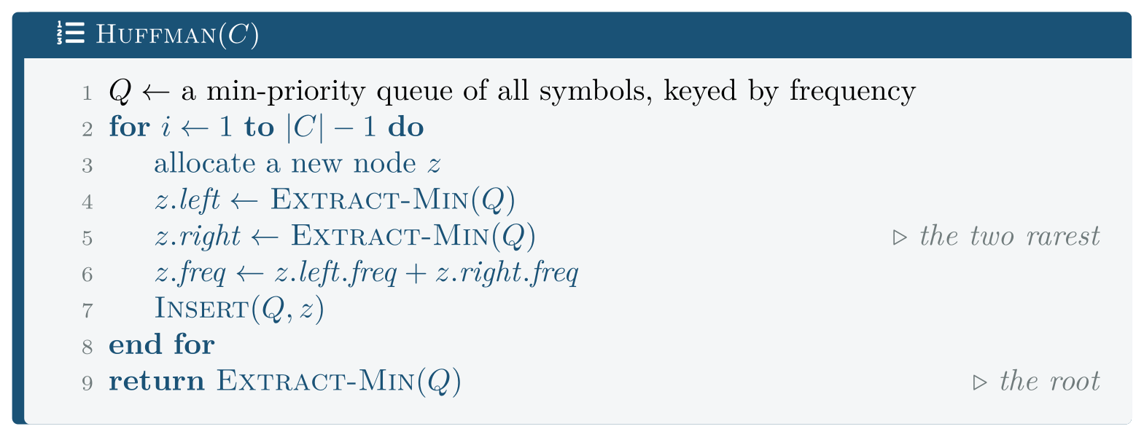
Huffman Coding
FIGURE 14.2
Huffman. The greedy choice is on line 5: the two least frequent symbols are merged first, which puts them deepest. With a binary heap the running time is Θ(n lg n).
Analysis of Algorithms · Chapter 14 · Greedy Algorithms
§14.4 · Handout p. 116 21
Notes:
Figure 14.2 (handout p. 116): Huffman. The greedy choice is on line 5: the two least frequent symbols are merged first, which puts them deepest. With a binary heap the running time is Θ(n lg n).

Slide 22

The greedy choice is safe
LEMMA 14.2
Let x and y be two symbols of lowest frequency in C. Then there is an optimal prefix code for C in which x and y have the same (maximal) depth and differ only in the last bit.
Analysis of Algorithms · Chapter 14 · Greedy Algorithms
§14.4 · Handout p. 116 22
Notes:
Proof. Let T be an optimal tree, and let a and b be two sibling leaves of maximum depth in T (they exist: the deepest leaf has a sibling, or the tree could be improved by promoting it). Assume without loss of generality f(a) ≤ f(b) and f(x) ≤ f(y). Exchange x with a to form T′. The change in cost is B(T) − B(T′) = (f(a) − f(x))(dT(a) − dT(x)) ≥ 0, because f(x) ≤ f(a) (x is of lowest frequency) and dT(x) ≤ dT(a) (a is of maximal depth), making both factors non-negative. So B(T′) ≤ B(T). Exchanging y with b in T′ gives T′′ with B(T′′) ≤ B(T′) ≤ B(T) by the same argument. Since T was optimal, B(T′′) = B(T), so T′′ is also optimal — and in it x and y are sibling leaves at maximum depth.

Slide 23
Huffman’s algorithm is optimal
THEOREM 14.3
Huffman produces a prefix code of minimum total length.
Analysis of Algorithms · Chapter 14 · Greedy Algorithms
§14.4 · Handout p. 116 23
Notes:
Proof. By induction on |C|. The base case |C| = 2 is immediate: both codewords have length 1 and no code can do better. For the inductive step, let x, y be the two least frequent symbols and let C′ be C with x and y replaced by a single symbol z of frequency f(x)+f(y). By the inductive hypothesis, Huffman produces an optimal tree T′ for C′. Replacing z’s leaf by an internal node with children x and y gives a tree T for C with B(T) = B(T′) + f(x) + f(y), since x and y sit one level below where z was. The +f(x)+f(y) is a constant independent of the tree, so minimising B(T′) minimises B(T) over all trees in which x and y are siblings — and Lemma 14.2 says some optimal tree is of that form. Hence T is optimal.

Slide 24
Huffman Against the Entropy Bound
WORKED EXAMPLE
text | symbols | entropy H | Huffman | saving vs 8-bit
English prose | 22 | 3.9670 | 4.0130 | 49.8%
DNA (4 symbols) | 4 | 1.9999 | 2.0000 | 75.0%
95% one symbol | 6 | 0.4065 | 1.1202 | 86.0%
uniform bytes | 256 | 7.9953 | 8.0000 | 0.0%
Every row satisfies H ≤ Huffman < H+1, as the theory requires. Three of the four are within 0.05 bits of the floor.
Analysis of Algorithms · Chapter 14 · Greedy Algorithms
§14.4 · Handout p. 116 24
Notes:
Each click adds one step of the working. Ask for the next number before you reveal it.

Slide 25
Huffman Against the Entropy Bound (continued)
WORKED EXAMPLE
The third row is the interesting one. Entropy 0.4065, Huffman 1.1202 — a gap of 0.71 bits, nearly the whole slack the theorem allows. The reason is structural: Huffman assigns each symbol a whole number of bits, and the minimum is 1. When one symbol has probability 0.95 its information content is − lg 0.95 = 0.074 bits, and Huffman must spend 1. It cannot do better, and the loss is a factor of 2.8.
That is the known limit of Huffman coding, and the reason arithmetic coding exists — it can spend fractional bits per symbol and approaches H arbitrarily closely. A greedy algorithm that is provably optimal within its class can still be far from the information-theoretic bound, because the class itself is the constraint. Compare Chapter 10, where merge sort came within 1% of its floor; here the restriction to whole bits costs 175%.
Analysis of Algorithms · Chapter 14 · Greedy Algorithms
§14.4 · Handout p. 116 25
Notes:
Each click adds one step of the working. Ask for the next number before you reveal it.

Slide 26
Huffman Against the Entropy Bound (continued)
WORKED EXAMPLE
And the last row. With 256 equally likely bytes, H = 8 and Huffman produces exactly 8 bits per symbol — it saves nothing, correctly. Compression is possible only where there is structure to exploit, and a greedy algorithm cannot create any.
Analysis of Algorithms · Chapter 14 · Greedy Algorithms
§14.4 · Handout p. 116 26
Notes:
Each click adds one step of the working. Ask for the next number before you reveal it.

Slide 27

Common pitfalls
COMMON PITFALLS
✕
Saying “use a greedy algorithm” without naming the rule. Three rules for activity selection scored 100%, 94.5% and 62.1%.
✕
Concluding optimality from testing. “Take the shortest” was right in 94.5% of 20,000 random trials and is wrong.
✕
Assuming greedy works because it works for coins. It does — for {1,5,10,25}. For {1,3,4} it fails at the amount 6.
✕
Confusing the two properties. Optimal substructure alone gives dynamic programming. It is the greedy-choice property that permits committing without exploring.
✕
Proving the wrong direction in an exchange argument. You must show the optimal solution can be modified to contain the greedy choice — not that the greedy solution can be modified.
✕
Expecting Huffman to reach the entropy. It cannot spend fractional bits; measured, it was 175% above H on a highly skewed source.
Analysis of Algorithms · Chapter 14 · Greedy Algorithms
§14.4 · Handout p. 116 27
Notes:
For each pitfall, ask who has seen it happen. One real story beats five bullets.

Slide 28
Common pitfalls (continued)
COMMON PITFALLS
✕
Using Huffman on a uniform source. Measured saving: 0.0%.
Analysis of Algorithms · Chapter 14 · Greedy Algorithms
§14.4 · Handout p. 116 28
Notes:
For each pitfall, ask who has seen it happen. One real story beats five bullets.

Slide 29

Try it yourself: Three Rules, Two Coin Systems, One Code
TRY IT YOURSELF
Reproduces all three tables. Expect twenty-five minutes; part A runs 20,000 brute-force searches.
WHAT YOU WILL DO
1. Activity selection, greedy by earliest finish
2. Two plausible rules that are simply wrong
3. The oracle: every subset, checked
4. Coin change: greedy, and the optimum it sometimes misses
5. Huffman coding
6. Is the greedy rule actually optimal?
7. Coin change: the same algorithm, two coin systems
8. Huffman against the entropy bound
THIS WEEK'S LAB
WHAT YOU WILL RUN
RUNNABLE COPY
Week 10: Huffman coding on real text; measure the compression
1 listing, 50 lines of C++
code/ch14_greedy.cpp
Analysis of Algorithms · Chapter 14 · Greedy Algorithms
§14.4 · Handout p. 116 29
Notes:
Reproduces all three tables. Expect twenty-five minutes; part A runs 20,000 brute-force searches.

Slide 30
Three Rules, Two Coin Systems, One Code
LAB · STEP 1 OF 8
Activity selection, greedy by earliest finish
C++ · code/ch14_greedy.cpp
1
2
3
4
5
6
7
8
9
10
11
12
13
14
15
16
// ch14_greedy.cpp -- when a local choice can be trusted, and when not.
// Build: cl /O2 /EHsc /std:c++17 ch14_greedy.cpp (see Appendix A)
// --- 1. Activity selection, greedy by earliest finish --------------
// Sort by finishing time and take anything compatible. The claim is
// that the activity finishing first is in SOME optimal solution --
// the greedy-choice property, and what the chapter proves.
static int greedy_finish(std::vector<Act> a) {
std::sort(a.begin(), a.end(),
[](const Act& x, const Act& y) {
return x.finish < y.finish; });
int count = 0, last = -1;
for (const Act& x : a)
if (x.start >= last) { ++count; last = x.finish; }
return count;
}
Analysis of Algorithms · Chapter 14 · Greedy Algorithms
§14.4 · Handout p. 116 30
Notes:
Step 1: Activity selection, greedy by earliest finish. Read the code aloud; ask what each line would print before running it.

Slide 31
Three Rules, Two Coin Systems, One Code
LAB · STEP 2 OF 8
Two plausible rules that are simply wrong
C++ · code/ch14_greedy.cpp
18
19
20
21
// --- 2. Two plausible rules that are simply wrong ------------------
// Both "take the shortest" and "take the earliest starting" sound
// just as reasonable as rule 1. Neither is optimal, and the program
// finds the counter-examples by brute force rather than asserting it.
Analysis of Algorithms · Chapter 14 · Greedy Algorithms
§14.4 · Handout p. 116 31
Notes:
Step 2: Two plausible rules that are simply wrong. Read the code aloud; ask what each line would print before running it.

Slide 32
Three Rules, Two Coin Systems, One Code
LAB · STEP 3 OF 8
The oracle: every subset, checked
C++ · code/ch14_greedy.cpp
23
24
25
// --- 3. The oracle: every subset, checked --------------------------
// Chapter 7's lesson. n <= 18 so 2^n is affordable, and it is the
// only way to be sure the greedy answers are right, not plausible.
Analysis of Algorithms · Chapter 14 · Greedy Algorithms
§14.4 · Handout p. 116 32
Notes:
Step 3: The oracle: every subset, checked. Read the code aloud; ask what each line would print before running it.

Slide 33
Three Rules, Two Coin Systems, One Code
LAB · STEP 4 OF 8
Coin change: greedy, and the optimum it sometimes misses
C++ · code/ch14_greedy.cpp
27
28
29
30
31
32
33
34
35
36
37
// --- 4. Coin change: greedy, and the optimum it sometimes misses ---
// Greedy takes the largest coin that fits. For {1, 5, 10, 25} that is
// optimal; for {1, 3, 4} it is not, and the smallest counter-example
// is six. Dynamic programming (Chapter 15) gets it right for any
// system.
static int coins_greedy(std::vector<int> c, int amount) {
std::sort(c.rbegin(), c.rend());
int used = 0;
for (int v : c) while (amount >= v) { amount -= v; ++used; }
return amount == 0 ? used : -1;
}
Analysis of Algorithms · Chapter 14 · Greedy Algorithms
§14.4 · Handout p. 116 33
Notes:
Step 4: Coin change: greedy, and the optimum it sometimes misses. Read the code aloud; ask what each line would print before running it.

Slide 34
Three Rules, Two Coin Systems, One Code
LAB · STEP 5 OF 8
Huffman coding
C++ · code/ch14_greedy.cpp
39
40
41
42
43
44
// --- 5. Huffman coding ---------------------------------------------
// Repeatedly merge the two least frequent symbols. The greedy choice
// is that the two rarest symbols can be put deepest, as siblings.
// Total encoded length = sum over leaves of freq * depth, which is
// also the sum of every internal node's frequency -- a neater way to
// compute it than walking the tree.
Analysis of Algorithms · Chapter 14 · Greedy Algorithms
§14.4 · Handout p. 116 34
Notes:
Step 5: Huffman coding. Read the code aloud; ask what each line would print before running it.

Slide 35
Three Rules, Two Coin Systems, One Code
LAB · STEP 6 OF 8
Is the greedy rule actually optimal?
C++ · code/ch14_greedy.cpp
46
// --- 6. Is the greedy rule actually optimal? -----------------------
Analysis of Algorithms · Chapter 14 · Greedy Algorithms
§14.4 · Handout p. 116 35
Notes:
Step 6: Is the greedy rule actually optimal?. Read the code aloud; ask what each line would print before running it.

Slide 36
Three Rules, Two Coin Systems, One Code
LAB · STEP 7 OF 8
Coin change: the same algorithm, two coin systems
C++ · code/ch14_greedy.cpp
47
// --- 7. Coin change: the same algorithm, two coin systems ----------
Analysis of Algorithms · Chapter 14 · Greedy Algorithms
§14.4 · Handout p. 116 36
Notes:
Step 7: Coin change: the same algorithm, two coin systems. Read the code aloud; ask what each line would print before running it.

Slide 37
Three Rules, Two Coin Systems, One Code
LAB · STEP 8 OF 8
Huffman against the entropy bound
C++ · code/ch14_greedy.cpp
48
49
50
// --- 8. Huffman against the entropy bound --------------------------
// Shannon: no prefix code can average fewer than H bits per symbol,
// and Huffman is always within 1 bit of it. Both are checkable.
Analysis of Algorithms · Chapter 14 · Greedy Algorithms
§14.4 · Handout p. 116 37
Notes:
Step 8: Huffman against the entropy bound. Read the code aloud; ask what each line would print before running it.

Slide 38
What the lab shows
TRY IT YOURSELF
What to notice. Part 6’s middle column. A rule that is right 94.5% of the time is not 94.5% of a correct algorithm — it is wrong, and the 5.5% is where it will meet your data.
Then try to break it. Find the smallest instance on which “take the shortest” fails, by searching exhaustively over instances rather than sampling. Three activities suffice: [0,10), [9,12) and [11,20) — the shortest is the middle one, taking it forbids both others, and the optimum takes the outer two. Having the counter-example in hand is worth more than the 94.5%.
Analysis of Algorithms · Chapter 14 · Greedy Algorithms
§14.4 · Handout p. 116 38
Notes:
Read the box aloud, then ask for an example from the room before moving on.

Slide 39
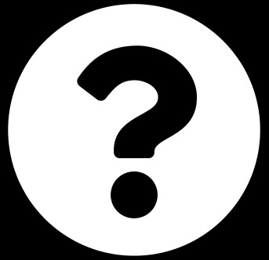
State the greedy-choice property and optimal substructure, and give a problem that has the second but not the first.
CHECKPOINT 1 OF 3
Discuss with the person next to you, then advance.
Analysis of Algorithms · Chapter 14 · Greedy Algorithms
Handout p. 120 · answers in Appendix D 39
Notes:
Ask the room. Do not advance until someone commits to an answer.

Slide 40

State the greedy-choice property and optimal substructure, and give a problem that has the second but not the first.
CHECKPOINT 1 OF 3 · ANSWER
Greedy-choice property: some optimal solution contains the locally best first choice. Optimal substructure: an optimal solution contains optimal solutions to the subproblems remaining after that choice. A problem with the second and not the first: 0/1 knapsack. Its optimal solution does contain optimal sub-solutions, so dynamic programming works (Chapter 16); but taking the highest value-per-weight item first can be wrong, so greedy fails. Coin change with {1,3,4} is the same story.
Analysis of Algorithms · Chapter 14 · Greedy Algorithms
Handout p. 120 · answers in Appendix D 40
Notes:
Answer (Appendix D): Greedy-choice property: some optimal solution contains the locally best first choice. Optimal substructure: an optimal solution contains optimal solutions to the subproblems remaining after that choice. A problem with the second and not the first: 0/1 knapsack. Its optimal solution does contain optimal sub-solutions, so dynamic programming works (Chapter 16); but taking the highest value-per-weight item first can be wrong, so greedy fails. Coin change with {1,3,4} is the same story.

Slide 41
Greedy coin change fails for {1,3,4} at the amount 6. Find the next amount at which it fails, and say why the counter-examples are small.
CHECKPOINT 2 OF 3
Discuss with the person next to you, then advance.
Analysis of Algorithms · Chapter 14 · Greedy Algorithms
Handout p. 120 · answers in Appendix D 41
Notes:
Ask the room. Do not advance until someone commits to an answer.

Slide 42
Greedy coin change fails for {1,3,4} at the amount 6. Find the next amount at which it fails, and say why the counter-examples are small.
CHECKPOINT 2 OF 3 · ANSWER
8. Greedy takes 4+3+1 = three coins; optimal is 4+4 = two. (The first failure is 6, as the chapter says; 7 is 4+3 for both.) The counter-examples are small because greedy’s mistake is made at the first step, so the smallest instance exhibiting it is the smallest amount where the largest coin is the wrong first choice — and that is bounded by the largest denomination.
Analysis of Algorithms · Chapter 14 · Greedy Algorithms
Handout p. 120 · answers in Appendix D 42
Notes:
Answer (Appendix D): 8. Greedy takes 4+3+1 = three coins; optimal is 4+4 = two. (The first failure is 6, as the chapter says; 7 is 4+3 for both.) The counter-examples are small because greedy’s mistake is made at the first step, so the smallest instance exhibiting it is the smallest amount where the largest coin is the wrong first choice — and that is bounded by the largest denomination.

Slide 43
Huffman achieved 1.1202 bits per symbol against an entropy of 0.4065. Explain the gap without blaming the algorithm.
CHECKPOINT 3 OF 3
Discuss with the person next to you, then advance.
Analysis of Algorithms · Chapter 14 · Greedy Algorithms
Handout p. 120 · answers in Appendix D 43
Notes:
Ask the room. Do not advance until someone commits to an answer.

Slide 44
Huffman achieved 1.1202 bits per symbol against an entropy of 0.4065. Explain the gap without blaming the algorithm.
CHECKPOINT 3 OF 3 · ANSWER
Huffman assigns each symbol a whole number of bits, with a minimum of 1. A symbol of probability 0.95 carries only − lg 0.95 = 0.074 bits of information, and Huffman must spend 1 on it. The algorithm is provably optimal among prefix codes; the restriction to integer code lengths is what costs the 0.71 bits, and arithmetic coding, which can spend fractional bits, removes it.
Analysis of Algorithms · Chapter 14 · Greedy Algorithms
Handout p. 120 · answers in Appendix D 44
Notes:
Answer (Appendix D): Huffman assigns each symbol a whole number of bits, with a minimum of 1. A symbol of probability 0.95 carries only − lg 0.95 = 0.074 bits of information, and Huffman must spend 1 on it. The algorithm is provably optimal among prefix codes; the restriction to integer code lengths is what costs the 0.71 bits, and arithmetic coding, which can spend fractional bits, removes it.

Slide 45

What to take away
CHAPTER SUMMARY
1
A greedy algorithm commits to the locally best choice and never reconsiders. It is optimal when the problem has both the greedy-choice property and optimal substructure.
2
Optimality is proved by an exchange argument: show that some optimal solution can be modified to contain the greedy choice without getting worse.
3
Measured: of three plausible activity-selection rules, earliest-finish was optimal on 100.0% of 20,000 random instances, shortest-first on 94.5% and earliest-start on 62.1%. Testing cannot distinguish a theorem from luck.
4
Measured: greedy coin change is optimal for {1,5,10,25} and wrong on 49 of 200 amounts for {1,3,4}, first failing at 6. Greediness is a property of the instance, not of the code.
5
Huffman’s algorithm is greedy — merge the two rarest symbols — and provably produces a minimum-length prefix code.
Analysis of Algorithms · Chapter 14 · Greedy Algorithms
Handout p. 120 45
Notes:
Ask the room to say each takeaway before you reveal it.

Slide 46
What to take away (continued)
CHAPTER SUMMARY
6
Measured: Huffman lay in [H, H+1) on all four corpora. On a 95%-skewed source it used 1.1202 bits against an entropy of 0.4065, because it cannot spend fractional bits; on a uniform source it saved nothing, correctly.
Analysis of Algorithms · Chapter 14 · Greedy Algorithms
Handout p. 120 46
Notes:
Ask the room to say each takeaway before you reveal it.

Slide 47

Quick check 1 of 2
REVIEW · MULTIPLE CHOICE
The greedy-choice property states that:
some optimal solution contains the greedy first choice
A
the greedy solution is unique
B
the problem has no optimal substructure
C
every optimal solution is greedy
D
Analysis of Algorithms · Chapter 14 · Greedy Algorithms
Handout p. 120 47
Notes:
Take a show of hands for each option before discussing. (The handout does not print MCQ answers.)

Slide 48
Quick check 2 of 2
REVIEW · MULTIPLE CHOICE
Huffman coding produces a code whose average length is:
at least the entropy and less than entropy +1
A
always equal to the entropy
B
C
always 8 bits
D
unrelated to the entropy
Analysis of Algorithms · Chapter 14 · Greedy Algorithms
Handout p. 120 48
Notes:
Take a show of hands for each option before discussing. (The handout does not print MCQ answers.)

Slide 49
For your notebook
REVIEW QUESTIONS
SHORT
Define the greedy strategy and apply it to activity selection, stating the rule precisely (CLO-6).
SHORT
Explain an exchange argument, and say which direction the modification goes.
SHORT
Why is a greedy rule that succeeds on 94.5% of random instances not acceptable?
APPLIED
Prove that greedy coin change is optimal for {1,5,10,25}, or give the argument’s outline and identify where it would fail for {1,3,4}.
APPLIED
You must schedule jobs with deadlines and profits, one machine, each job taking unit time, to maximise profit. Propose a greedy rule, attempt an exchange argument, and either prove it or give a counter-example.
Analysis of Algorithms · Chapter 14 · Greedy Algorithms
Handout p. 120 49
Notes:
Set these for independent study. Model answers are not printed in the handout.

Slide 50
End of Chapter 14
14
NEXT
READ
Chapter 15 — Dynamic Programming I: The Elements
Handout Chapter 14, pages 113–120
THIS WEEK'S LAB
Huffman coding on real text; measure the compression
Analysis of Algorithms · Chapter 14 · Greedy Algorithms
50
Notes:
Close. NEXT: Chapter 15 — Dynamic Programming I: The Elements. READ: Handout Chapter 14, pages 113–120. THIS WEEK'S LAB: Huffman coding on real text; measure the compression.

